Slide 1
Rust for Solana
Developer Crash Course

Slide 2
Installation
Using Rustup*
curl --proto '=https' --tlsv1.2 -sSf https://sh.rustup.rs | sh
OR Brew
brew install rustup-init
* Recommended

Slide 3
IDE Setup (Visual Studio Code)
Plugins to Install
Rust-analyzer
Rust Syntax
* Don’t install Rust and Rust-analyzer together. It’s having conflict. Rust-analyzer is better than Rust plugin.

Slide 4
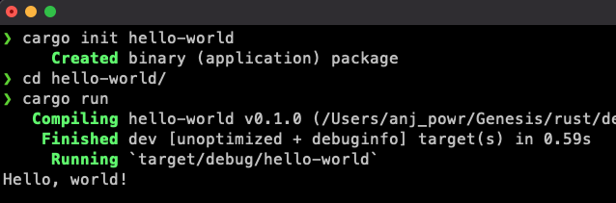
Hello World
In Terminal, type cargo init hello-world
Go inside to the hello-world folder
Type cargo run

Slide 5
What is Cargo
Rust’s build system and package manager
Similar to npm or pip

Slide 6
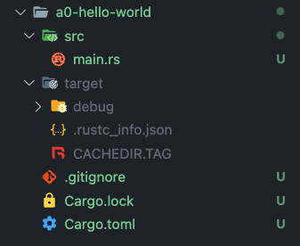
Cargo Project Structure
src Where rust code lives
target Where compiled files stores
Cargo.toml Similar to package.json

Slide 7
Fundamentals

Slide 8
Basic Data Types
Type | Example | Notes
Boolean | Yes/ No
Integer | 1, 2, 50, 199, -5 | Negative numbers also integers Can be signed and unsigned
Double / Float | 1.1, 420.69, 2.0, -5.9
Character | ‘A’, ‘c’, ‘6’, ‘$’ | Representing with single quotes
String | “Hello”, “this is a string”, “It’s 40” | Representing with double quotes Support unicode

Slide 9
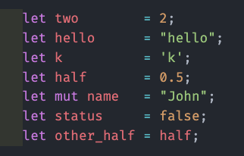
Variables
In Rust, variables are immutable by default
But, can set as mutable using mut keyword
Note : Have to end with semicolon after declaring a variable

Slide 10
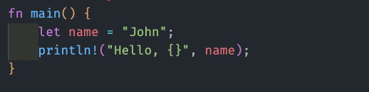
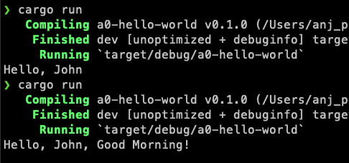
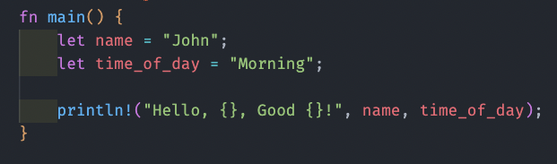
How to print variables
Variables are passing using curly brackets.

Slide 11
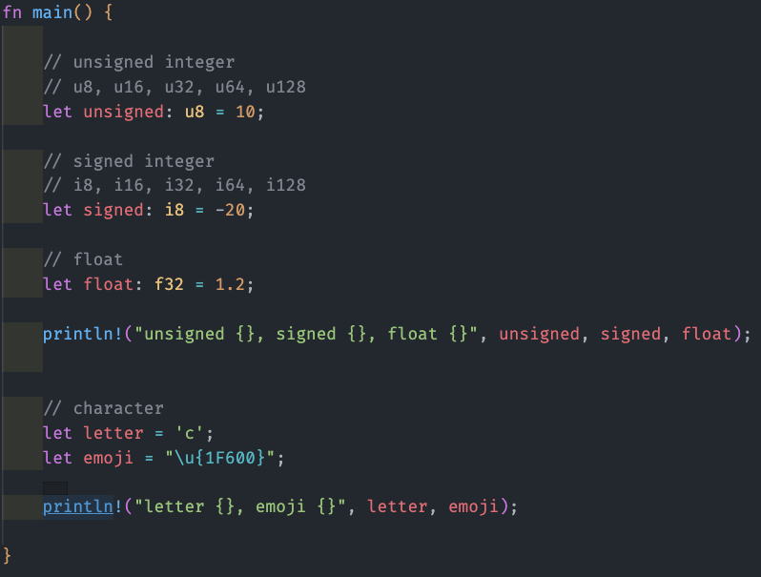
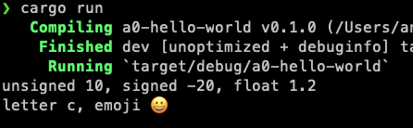
Variables - Con’t

Slide 12
Arrays & Slices - Anatomy
let array_variable_name: [type; array_size] = [“array”,”values”];
let slice_variable_name: &arr_var_name[arr_idx_from .. arr_idx_to];

Slide 13
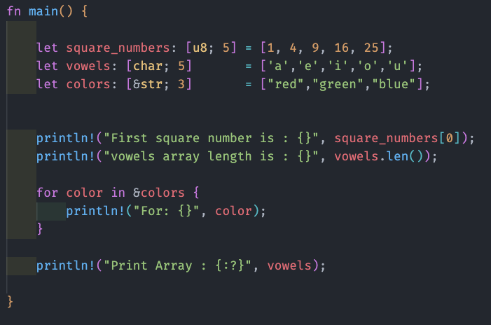
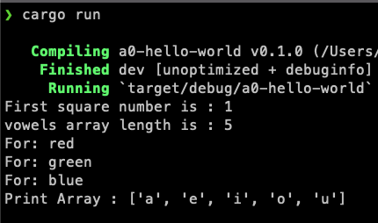
Arrays
{:?} = Debug mode

Slide 14
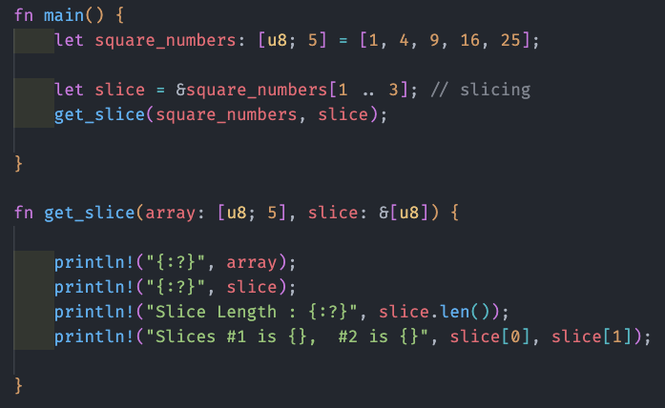
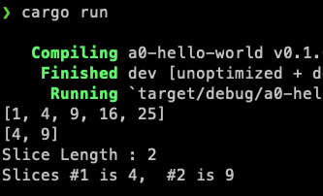
Slices
& = Borrowing data (Referencing)

Slide 15
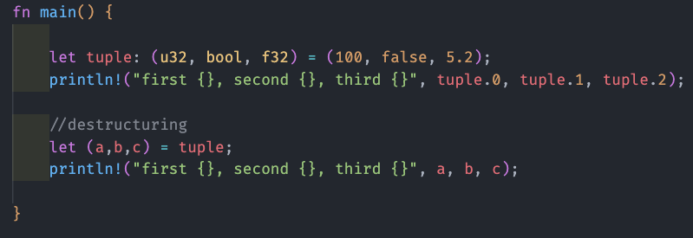
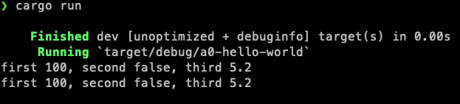
Tuple

Slide 16
Functions - Anatomy
visibility fn function_name (variable: variable_type) -> return_value_type {
// logic
}
* All functions are private by default in rust unless stated otherwise

Slide 17
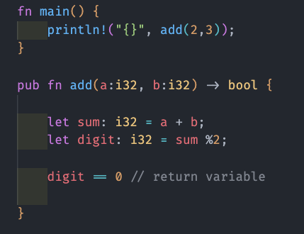
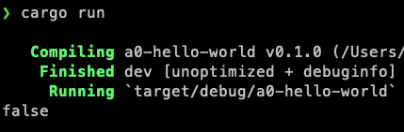
Functions

Slide 18
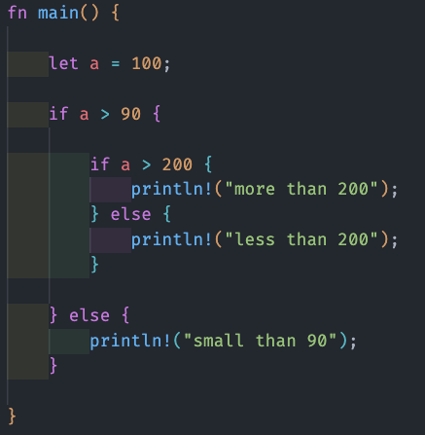
If Statement
Here, showing a nested if statement

Slide 19
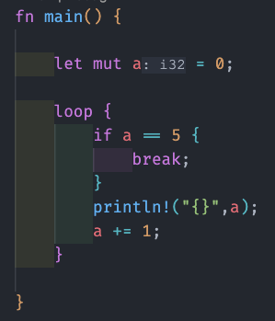
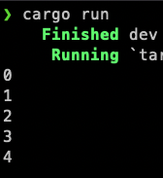
Infinite loop

Slide 20
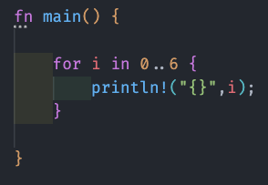
For loop

Slide 21
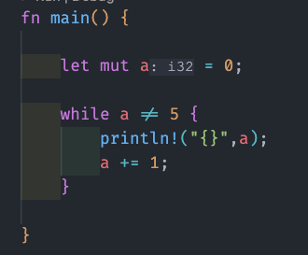
While loop

Slide 22
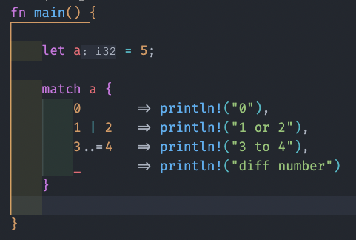
Match
match is very similar to switch statement
3..=4 - Here, 4 is included in the condition with =
_ means default

Slide 23
Intermediate

Slide 24
String
Two commonly used types of strings in rust
String - owned
&str - borrowed String slice
Strings are automatically borrowed in Rust
Must use an owned String to store in a struct
Use &str when passing to a function

Slide 25
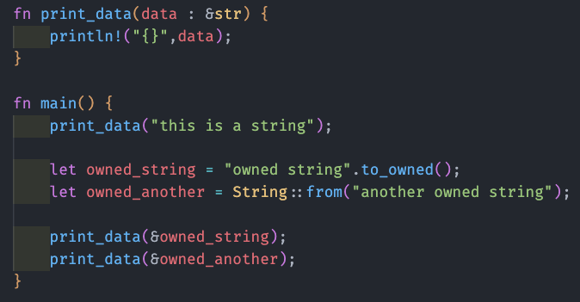
String

Slide 26
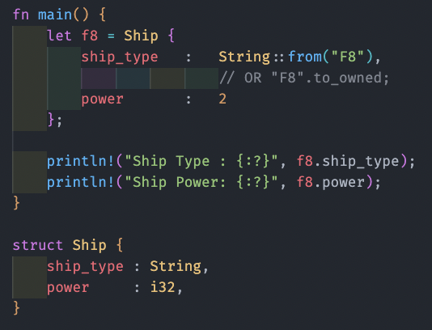
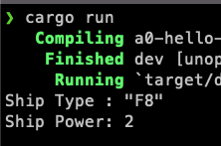
Struct

Slide 27
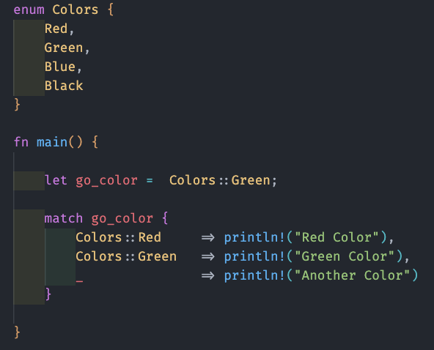
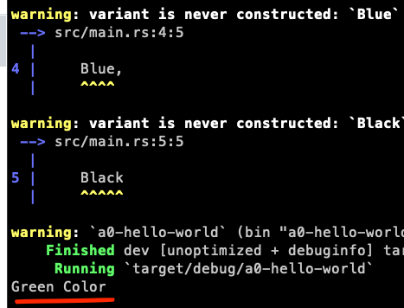
Enum

Slide 28
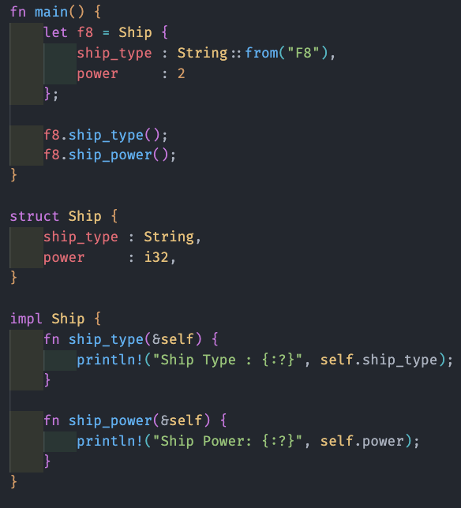
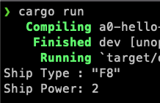
Impl
Allows to implement functionality on specific enum or struct
&self is similar to this in javascript
self.variable is similar to this ->variable

Slide 29
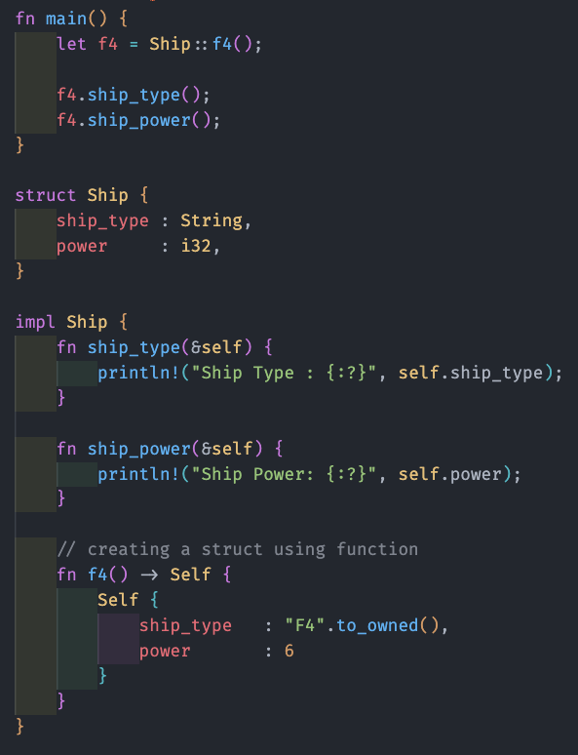
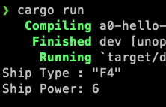
Impl - Con’t
Self (Capital S) is referring to struct/enum name
Ship::f4 is calling the function inside impl

Slide 30
Trait
Trait is the OOP solution for Rust (very similar approach)
Traits define similar functionality for different types
Trait functions are regular functions
Can accept arguments and return values
Trait should start with a capital letter
Use impl Trait as a function argument to pass data via trait

Slide 31
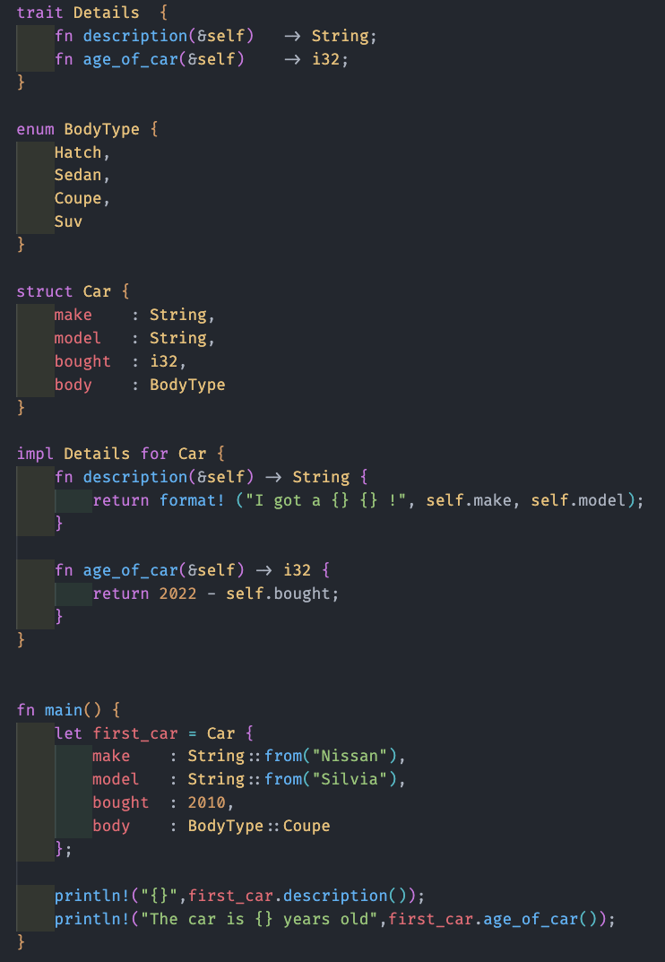
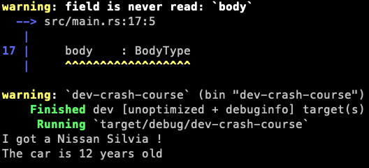

Slide 32
Vector
Allows to store multiple pieces of information
Must be the same type
Used for lists of information
Can add, remove the entries dynamically

Slide 33
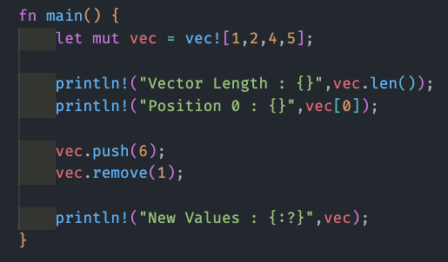
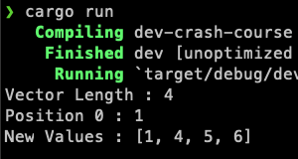
Vector

Slide 34
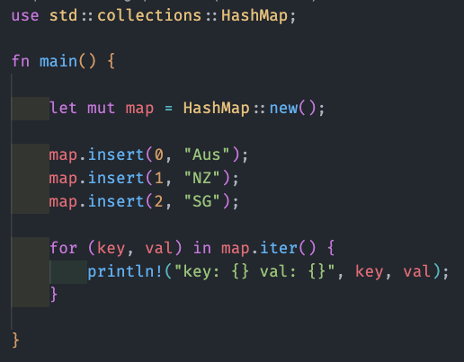
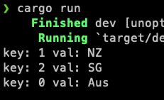
Hashmap
https://doc.rust-lang.org/std/index.html

Slide 35
Option
Option represents either some data or nothing
Some (variable_name) = Data is available
None = No data is available
Useful when needing to work with optional data
Use Option<type> to declare an optional type

Slide 36
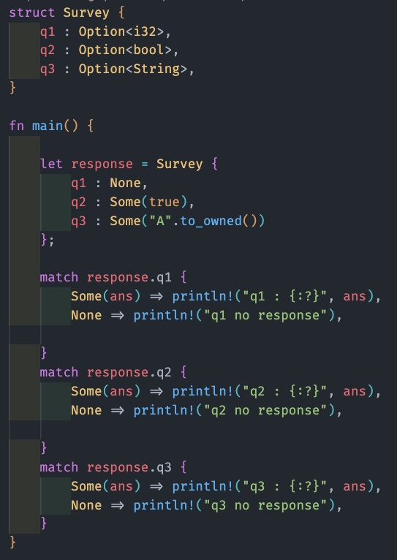
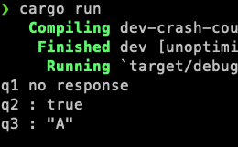

Slide 37
Advanced
What actually needs for Solana :)

Slide 38
Derive
Some functionalities can automatically implemented in enums and structs
No need to do manual borrowing/ referencing
Compiler will figure out what has to be done

Slide 39
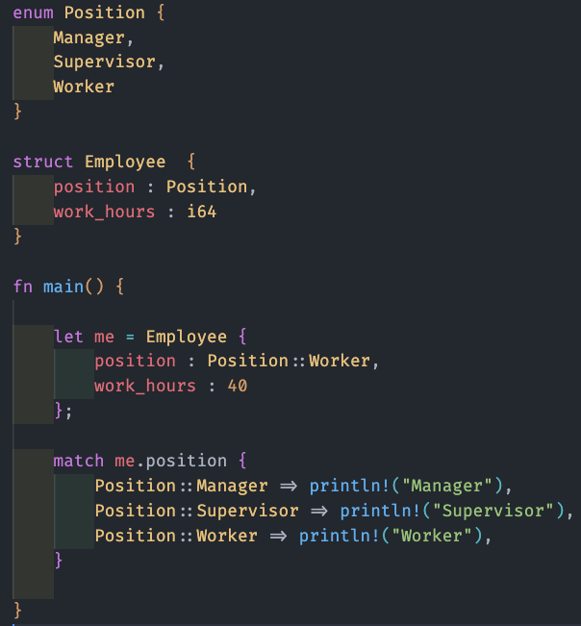
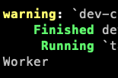
Without Derive Macro in Position Struct

Slide 40
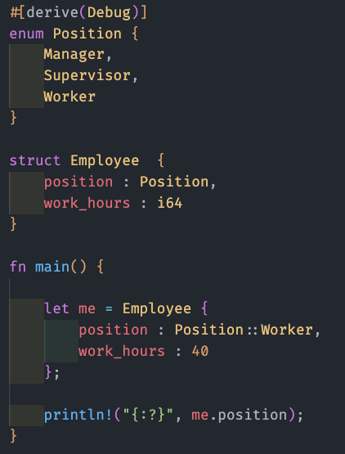
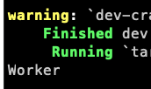
With Derive Macro in Position Struct

Slide 41
Without Derive Macro in Employee Struct

Slide 42
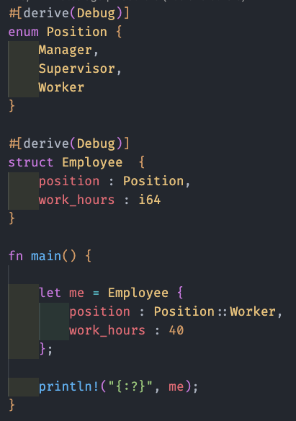

With Derive Macro in Employee Struct

Slide 43
Derive - Other Useful Macros
#[derive (Debug, Clone, Copy]

Slide 44
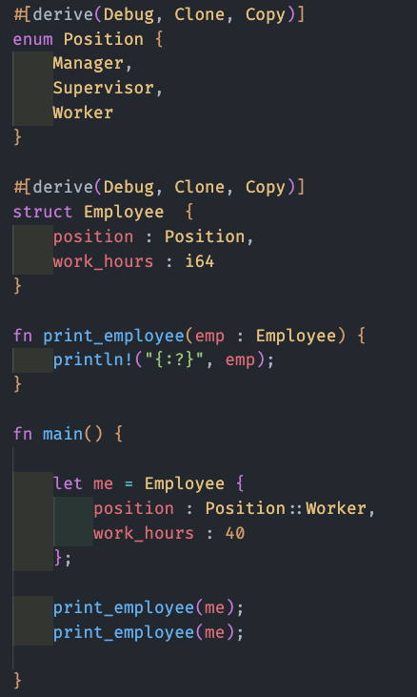


Slide 45
Result
A data type that contains one of two types of data
Successful data
Error data
Useful when working with functionality that can potentially fail

Slide 46
Result - Anatomy
fn get_choice(input: &str) -> Result<(T, E)> {
// logic
}
T and E here is arbitrary. You can pass any type (String, Arrays, Vectors) or errors, or keep it blank

Slide 47
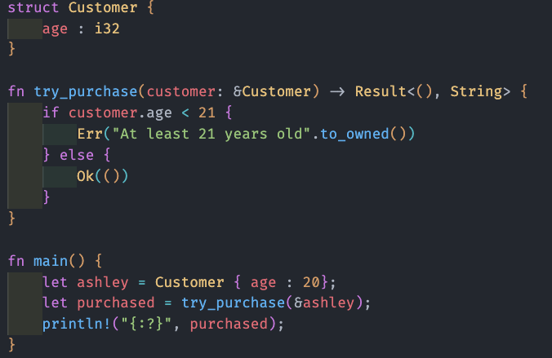
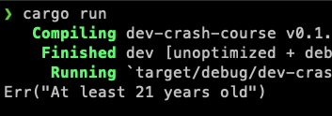

Slide 48
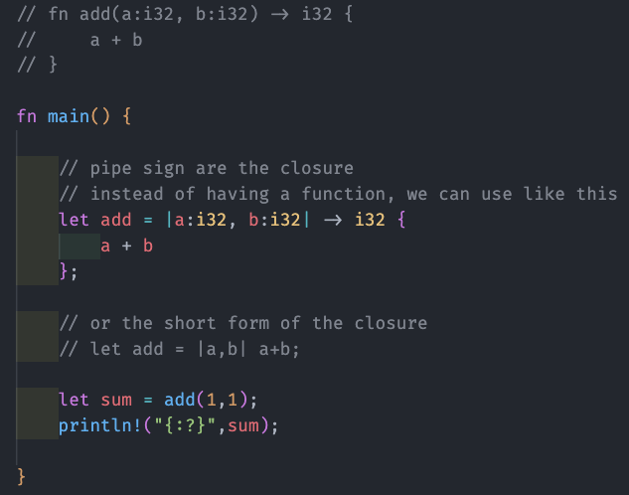
Closure

Slide 49
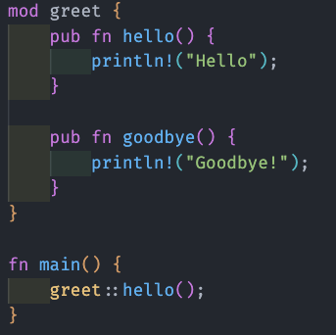
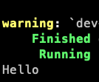
Modules
Can use to organize the code
Help to self contain and easier to follow

Slide 50


Lifetimes
Allow to store references and sometimes needed when creating functions

Slide 51
Closing

Slide 52


Generating Documentation
In terminal, run cargo doc --open

Slide 53
Standard Library Documentation (STD)
Can access the complete documentation from the below URL
https://doc.rust-lang.org/std/
It’s available locally as well. Run this command in terminal to bring up the page
rustup doc
It might will give an error in Mac because of M1 processors. Simply follow what’s showing on terminal.
rustup component add --toolchain stable-aarch64-apple-darwin rust-docs

Slide 54
Anchor

Slide 55
Create a SPL token using CLI (ERC20)
spl-token create-token
spl-token create-account <token_id>
spl-token mint <token_id> <amount>
spl-token supply <token_id>
spl-token balance
spl-token accounts
spl-token transfer --fund-recipient <token_id> <amount> <wallet_address>
spl-token burn <account_id> <amount>

Slide 56
Create a SPL token using CLI (NFT)
spl-token create-token --decimals 0
spl-token mint <token_id> 1
spl-token authorize <token_id> mint --disable

Slide 57
Thank You :)

